Slide 1
Node.js Course – 2nd Session
Express Overview
Lance Zhou
2016.08.28

Slide 2
Agenda
1
Express Introduction
2
A Simple Http Server by Express
3
Express Generator
4
Express Routing
5
Express Middleware
6
Third-party Middleware
7
Template Engine
8
Exercise

Slide 3
1
Express Introduction

Slide 4
1
What is Express
is a minimal and flexible Node.js web application framework
provides a robust set of features for web and mobile applications
install express
npm install express --save

Slide 5
2
A Simple Http Server by Express

Slide 6
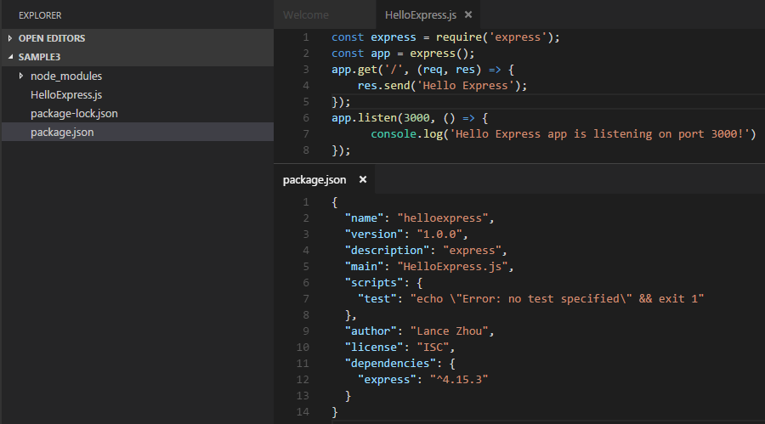
1
Build a simple http server by Express
npm init to build a package.json
npm install express –save
build HelloExpress.js file

Slide 7
3
Express Generator

Slide 8
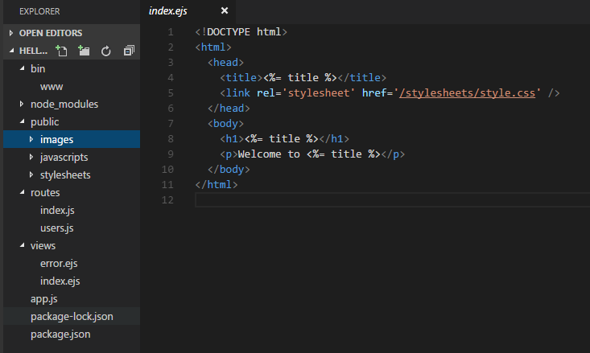
1
Express application generator
It’s used for creating an application skeleton
Install it by
npm install express-generator –g
Create application skeleton by
express –view=ejs helloexpress

Slide 9
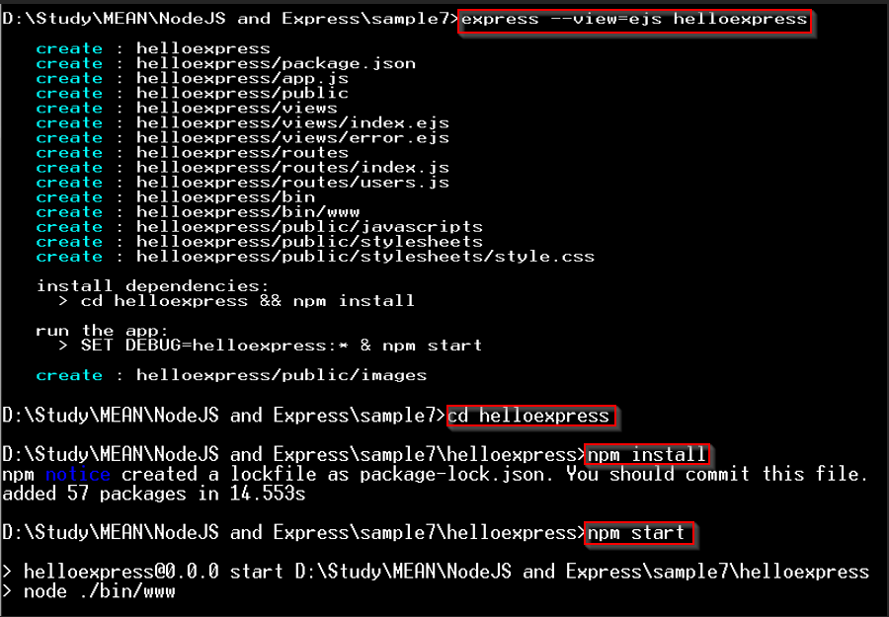
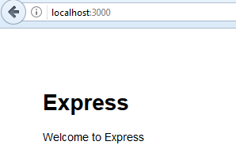
2
Express application generator

Slide 10
4
Express Routing

Slide 11

1
Routing
Routing refers to the definition of application end points (URIs) and how they respond to client requests.
HTTP Method
URI (path)
Handler
Notes:
What routing looks like

Slide 12
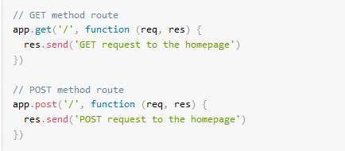
2
Route methods
A route method is derived from one of the HTTP methods, and is attached to an instance of the express class.

Slide 13

3
Route method – app.all()
This method is used for loading middleware functions at a path for all request methods.
Notes:
In the following example, the handler will be executed for requests to “/secret” whether you are using GET, POST, PUT, DELETE, or any other HTTP request method that is supported in the http module.

Slide 14
4
Routing paths
Route paths define the endpoints at which requests can be made.
Route paths can be strings, string patterns, or regular expressions.
Domain/server address
Request path

Slide 15
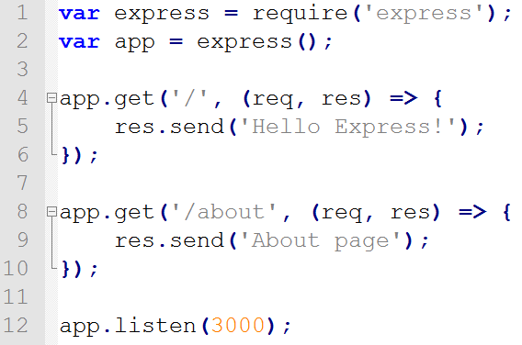
5
Route paths – String
http://localhost:3000
http://localhost:3000/about

Slide 16
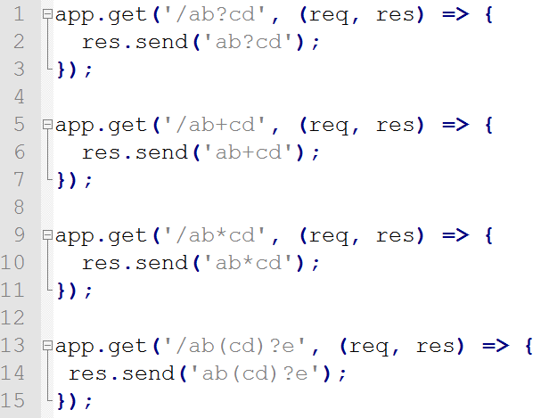
6
Route paths – String patterns
Support ?, +, * and ()
/acd, /abcd
/abcd, /abbcd, /abbbcd
/abcd, /abxcd, /ab12*cd
/abe, /abcde

Slide 17
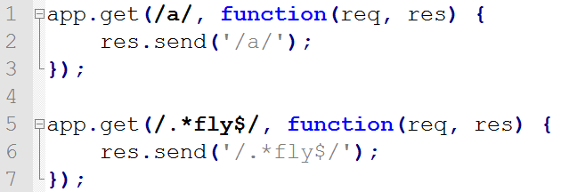
7
Route paths – regular expression
Use regular expression as a path definition
The path contains a
The path end with fly

Slide 18
8
Route paths – rule
First definition, first process
Don’t abuse patterns

Slide 19
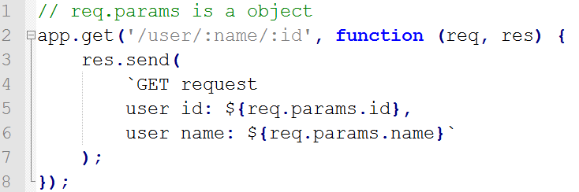
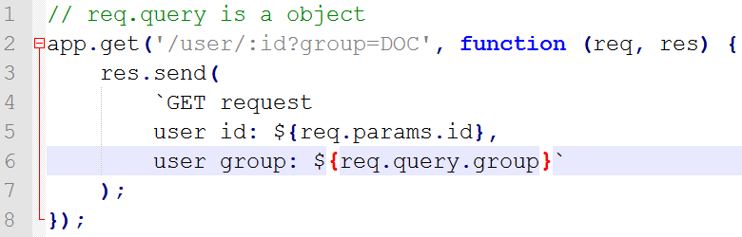
9
Route parameters
Route parameters are named URL segments that are used to capture the values specified at their position in the URL.
req.params
req.query

Slide 20
10
Route handlers
Each handler is a function, handle request & response
Handler form
Function
Array of function
Various combination of above both
Handler

Slide 21
11
Route handlers – next()
Use next() pass control to next handler
Use next(‘route’) pass control to next eligible route
Only works for app.METHOD or router.METHOD
Use next(err) or pass anything to the next() function (except the string 'route') to pass control to err handler

Slide 22
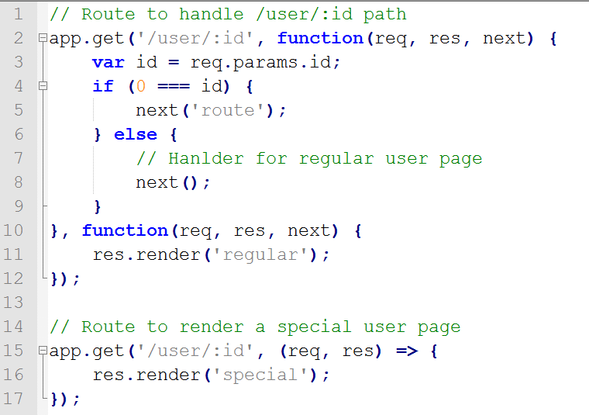
12
Route handlers – next()
Notes:
Understanding to next: https://cnodejs.org/topic/5757e80a8316c7cb1ad35bab

Slide 23
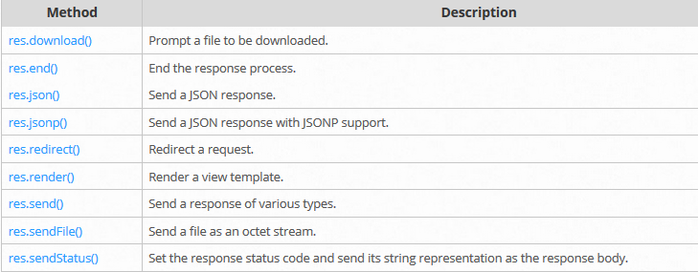
13
Response methods
The methods on the response object (res) in the following table can send a response to the client, and terminate the request-response cycle.

Slide 24
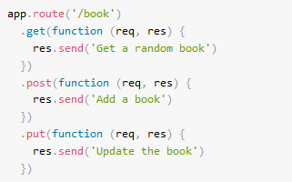
14
app.route()
You can create chainable route handlers for a route path by using app.route()

Slide 25
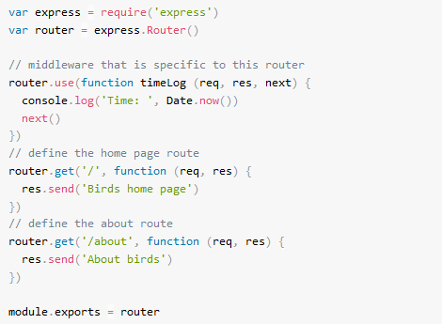
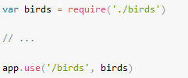
15
express.router()
Use the express.router class to create modular, mountable route handlers
Below app can handle requests to /birds and /birds/about

Slide 26
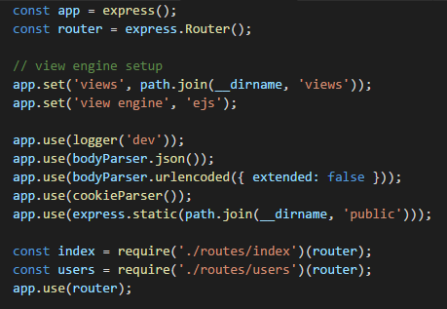
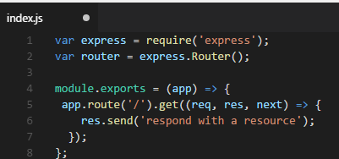
16
Express Project Practice
Use express() as app to do global configuration
Use an express.Router() instance to do business routing
Load the router by app.use(router)
Notes:
Demo Express_CH3_ExpressGenerator/helloexpress

Slide 27
5
Express Middleware

Slide 28
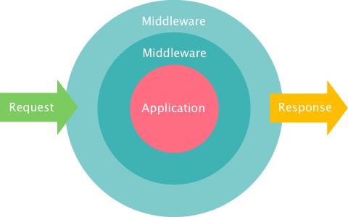
1
Middleware
A function
Can access
HTTP Request and Response
The next function, as middleware flow controller
Notes:
http://justinklemm.com/node-js-async-tutorial/

Slide 29
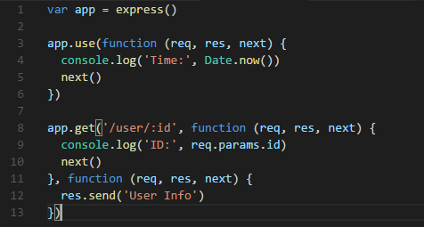
2
Middleware – Application level
Bind application-level middleware to an instance of the app object by using the app.use() and app.METHOD() functions

Slide 30
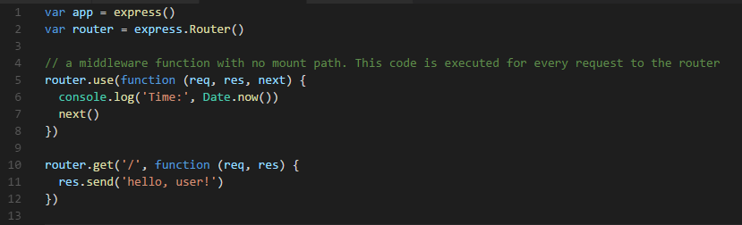
3
Middleware – Router level
Load router-level middleware by using the router.use() and router.METHOD() functions.

Slide 31
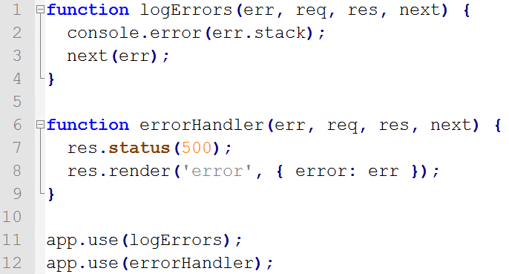
4
Middleware – Error-handling
Must provide 4 arguments(err, req, res, next) to identify it as an error-handling middleware function
When not calling next() in an error-handling function, you must end the response
Pass to next error middleware
(err != ‘route’)
No path, means all request will go through this middleware
Notes:
Notice that when not calling “next” in an error-handling function, you are responsible for writing (and ending) the response. Otherwise those requests will “hang” and will not be eligible for garbage collection.

Slide 32
6
Third-party Middleware
Notes:
http://expressjs.com/en/resources/middleware.html

Slide 33
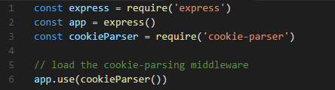
1
Middleware – Third-party
Use third-party middleware to add functionality to Express apps.
server-static is the only built-in middleware in express
Need install the third-party middleware before use
Get more useful middleware from here

Slide 34
7
Template Engine

Slide 35
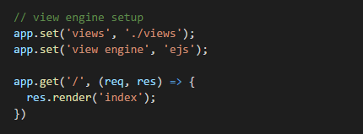
1
Template Engine
A template engine enables you to use static template files in your application.
At runtime, the template engine replaces variables in a template file with actual values, and transforms the template into an HTML file sent to the client.
Some popular template engines that work with Express
EJS
Pug (it’s used to be named as Jade)
Adopt template engine after install like below
app.set(‘views’, [view path])
app.set(‘view engine’, [engine name])
Convert index.ejs file to index.html based on “ejs” engine

Slide 36
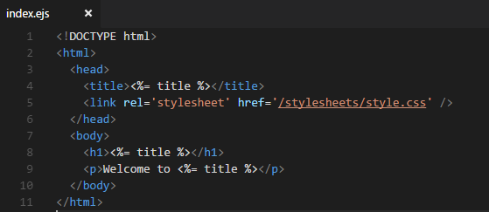
2
EJS Engine
An EJS “tag” is the primary functioning unit in an EJS template
Tags
<%= : outputs the escaped value into template
Notes:
Details refer to https://github.com/mde/ejs/blob/master/docs/syntax.md

Slide 37
8
Exercise

Slide 38
8
Reference
http://expressjs.com/

